Slide 1
DBMS
MINI PROJECT
RESTAURANT MANAGEMENT
TEAM 4
19S019 K. MUTHURAMAN
19S020 U. NEERAJA
19S021 S. NEHA
19S022 A. NITHILA PALETT
19S023 K.V. NITHYASRI
19S024 S. PON RISHIKESH

Slide 2
TABLE OF CONTENTS:
1.DESCRIPTION
2.ER DIAGRAM
3. SQL QUERIES
4. HTML CODE
5. OUTPUT SCREENSHOTS

Slide 3
DESCRIPTION
The restaurant maintains the catalog for the list of food and beverage items that it provides. Apart from providing food facility at their own premises, the restaurant takes orders online through their site. Orders on the phone are also entertained. To deliver the orders, we have delivery boys. Each delivery boy is assigned to the specific area code. The delivery boy cannot deliver outside the area which is not assigned to the delivery boy (for every delivery boy there can be single area assigned to that delivery boy). The customer record is maintained so that premium customer can be awarded discounts.
DELIVERABLES:
1.ER DIAGRAM OF ALL ENTITIES,RELATIONSHIPS AND THEIR DATA STRUCTURE
2.SQL QUERIES TO ORDER BOOKING ASSIGNMENT OF DELIVERY BOYS AND DELIVERY PLAN.

Slide 4
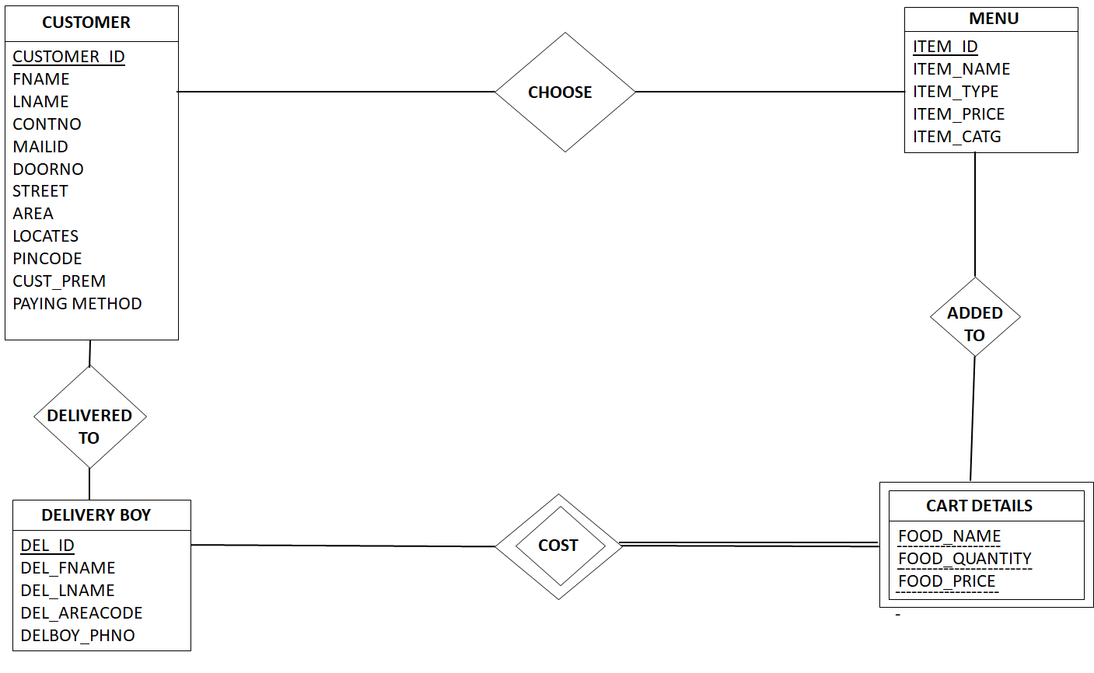
ER DIAGRAM

Slide 5
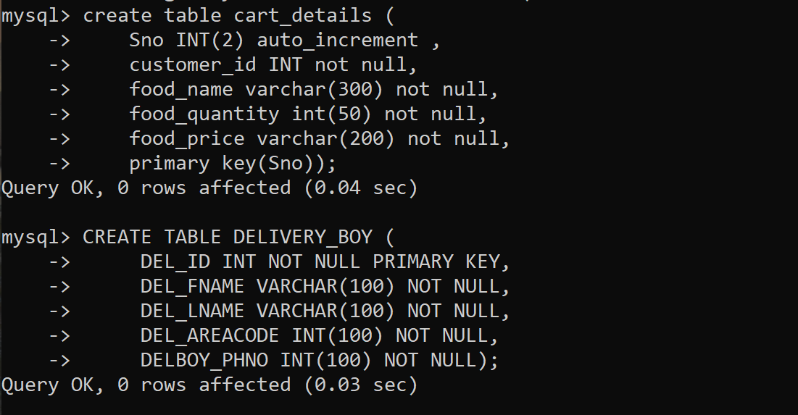
SQL QUERIES

Slide 6
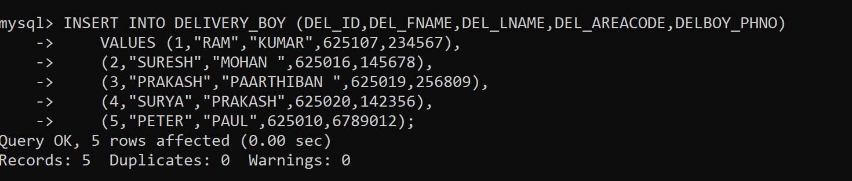

Slide 7
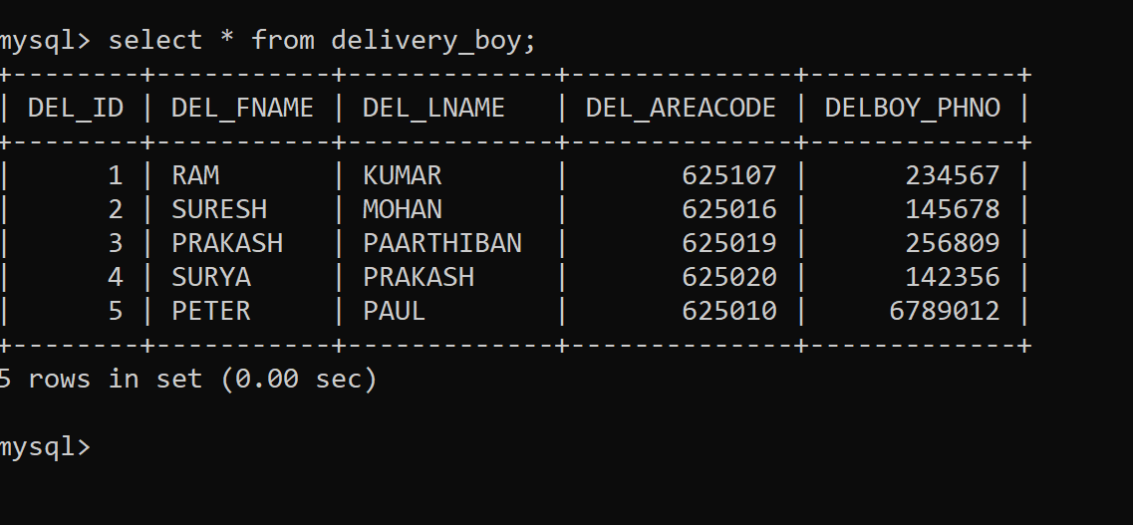

Slide 8
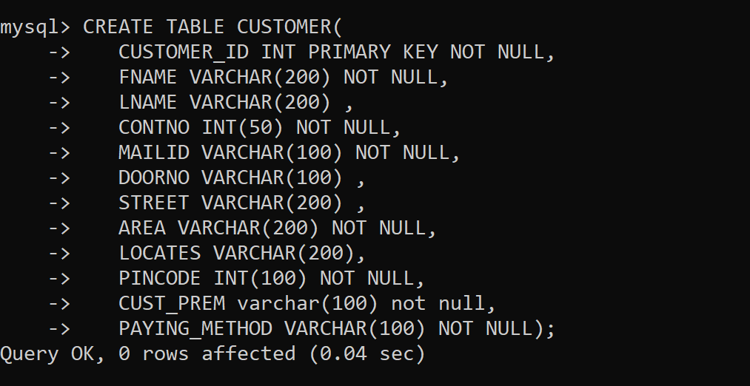

Slide 9
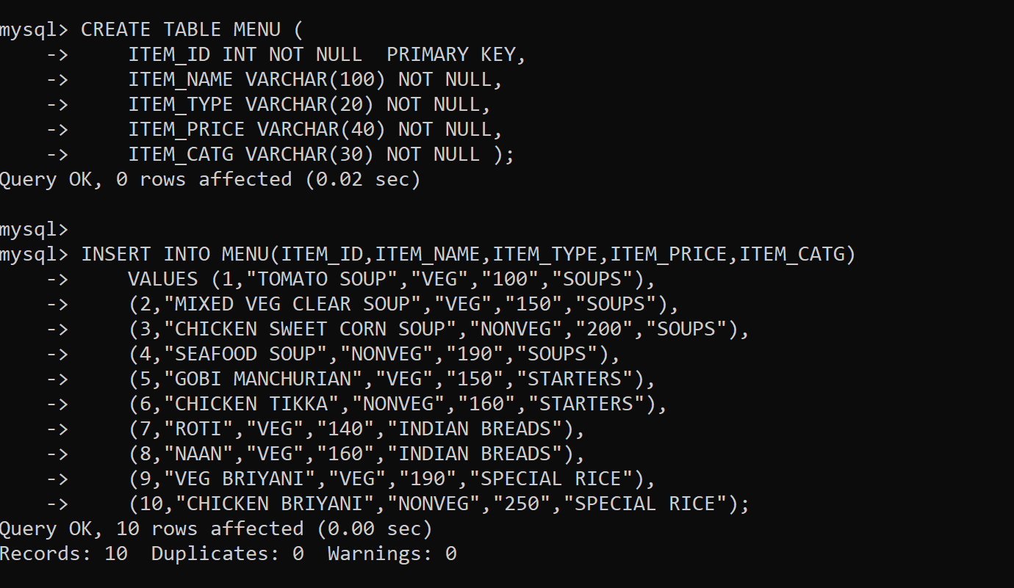

Slide 10
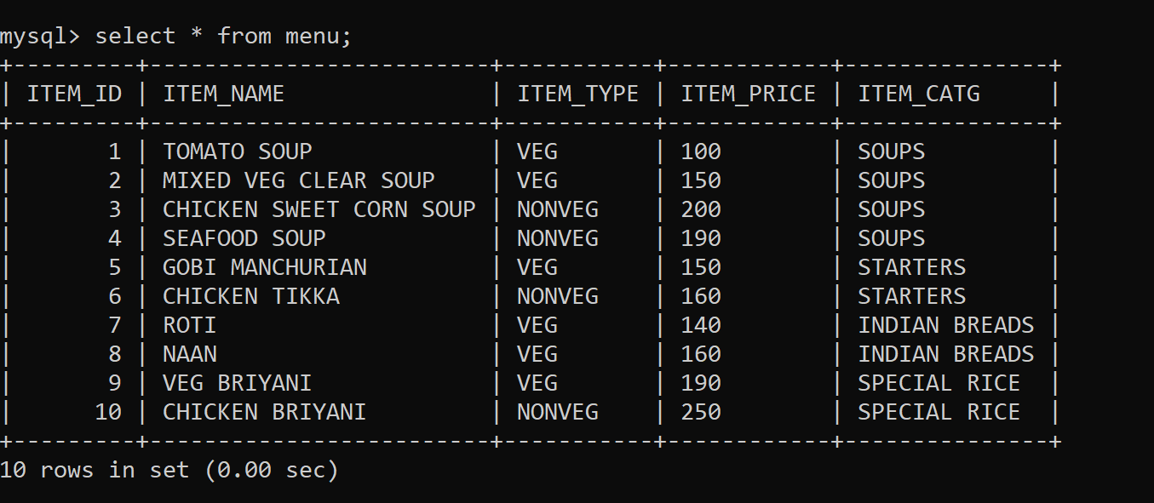

Slide 11
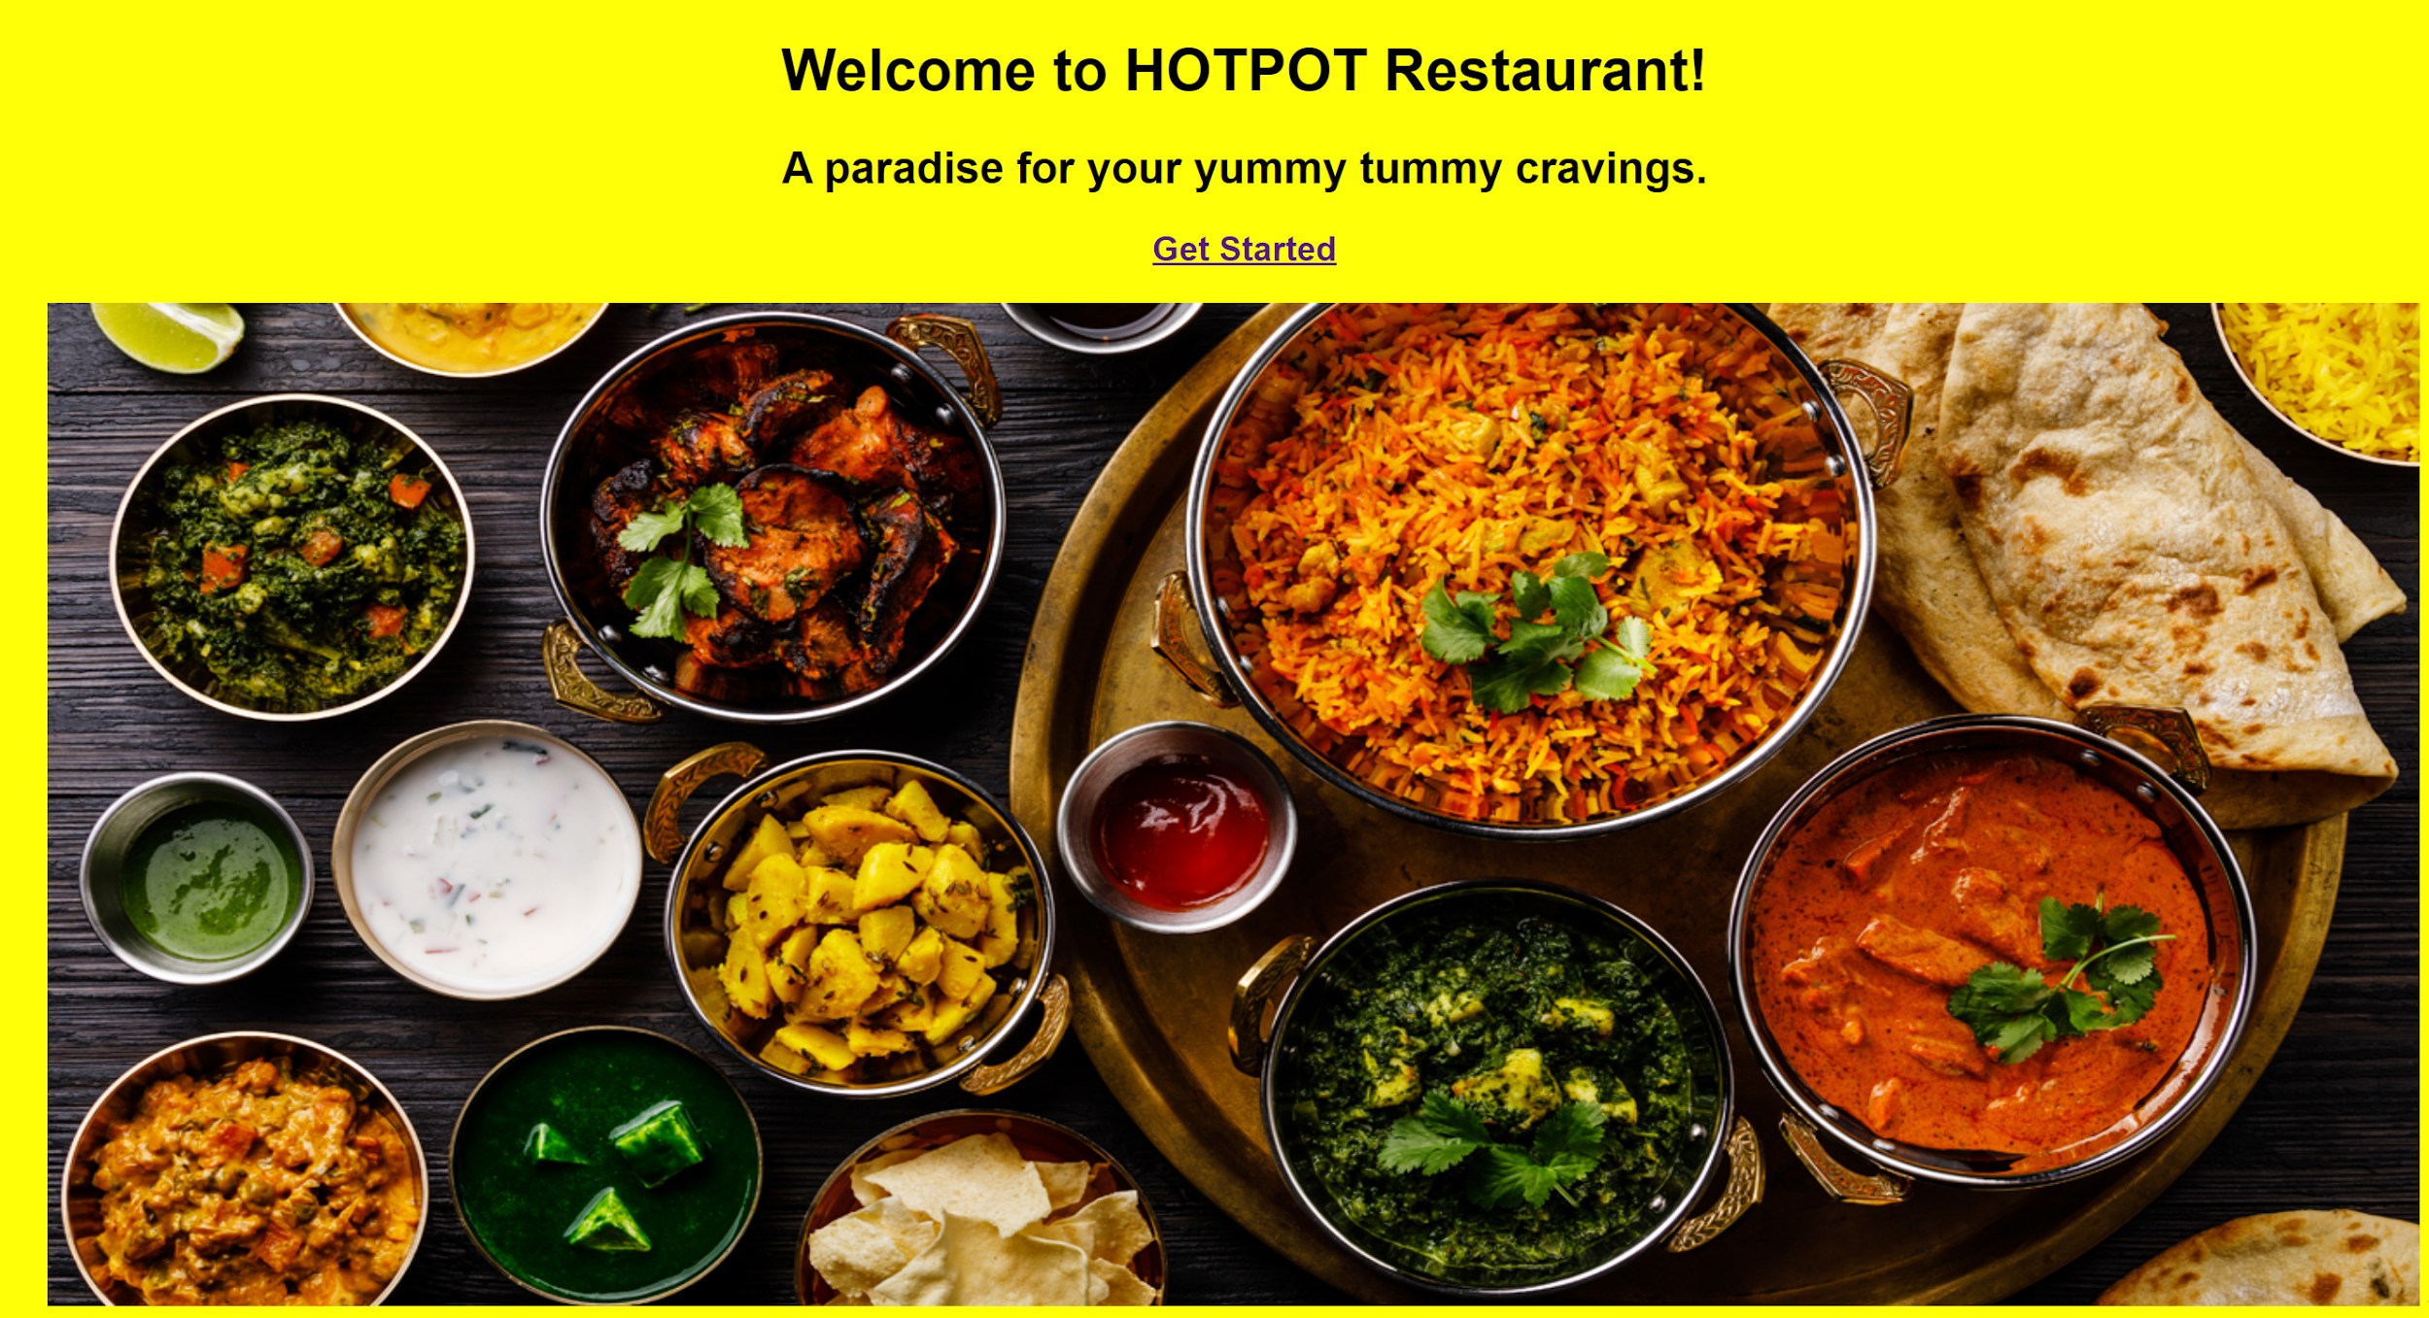

Slide 12
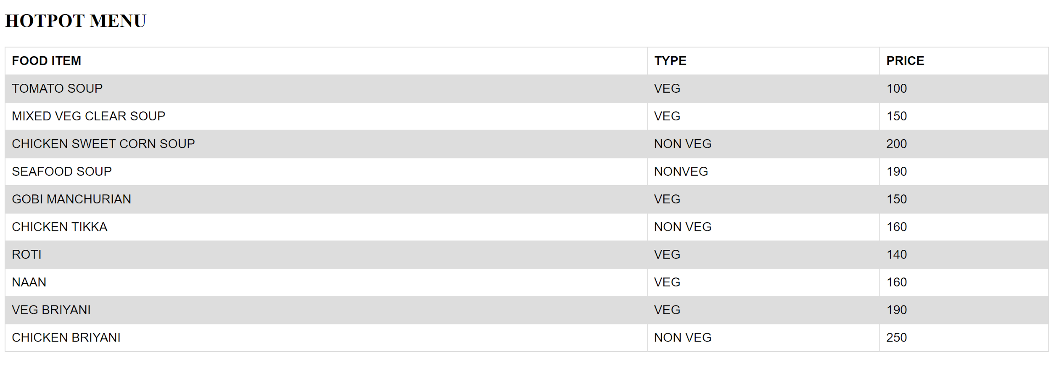

Slide 13
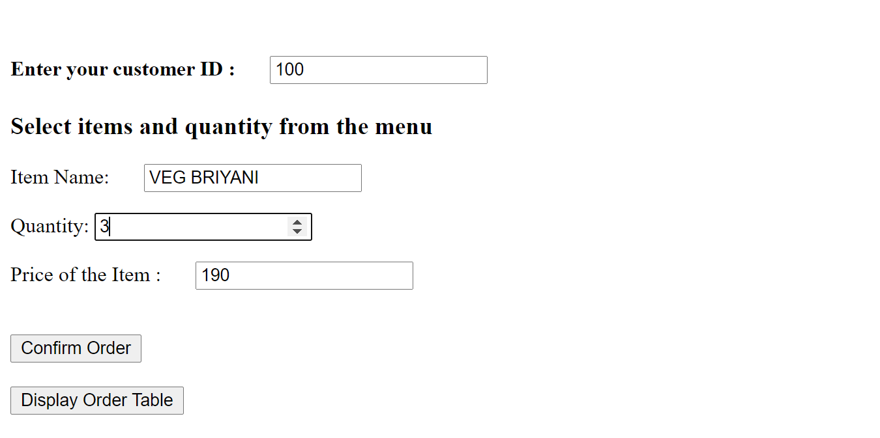

Slide 14
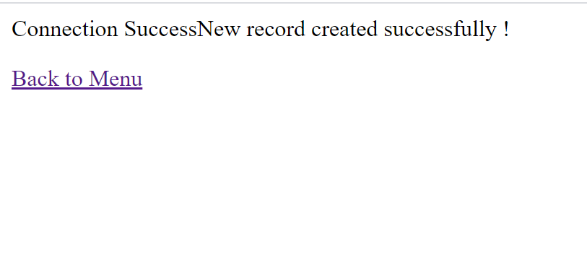

Slide 15
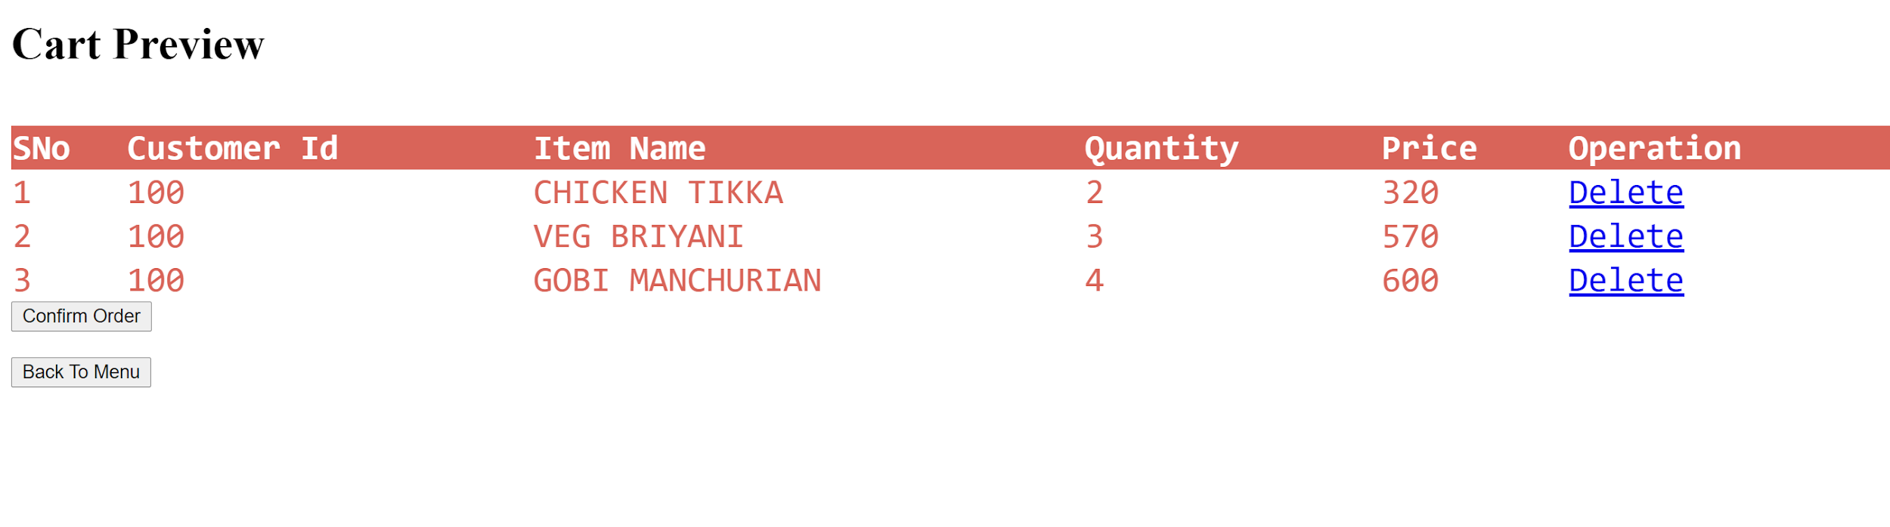

Slide 16
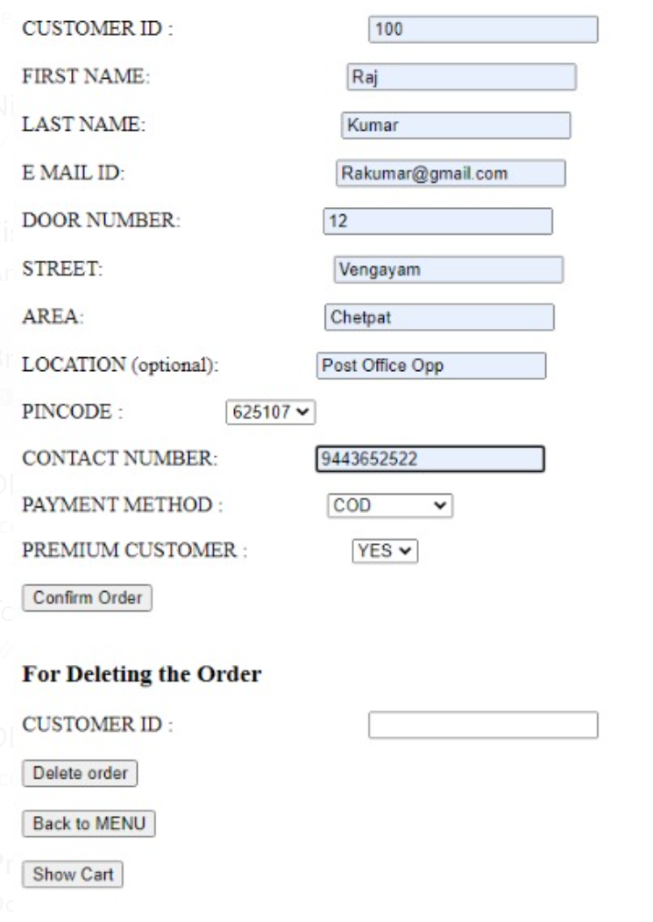

Slide 17
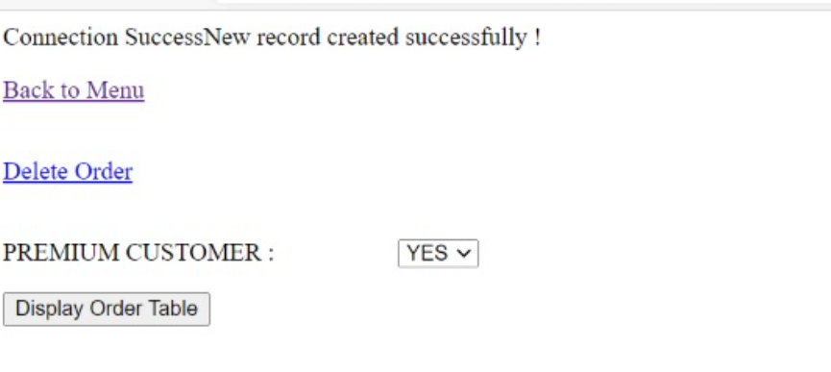

Slide 18
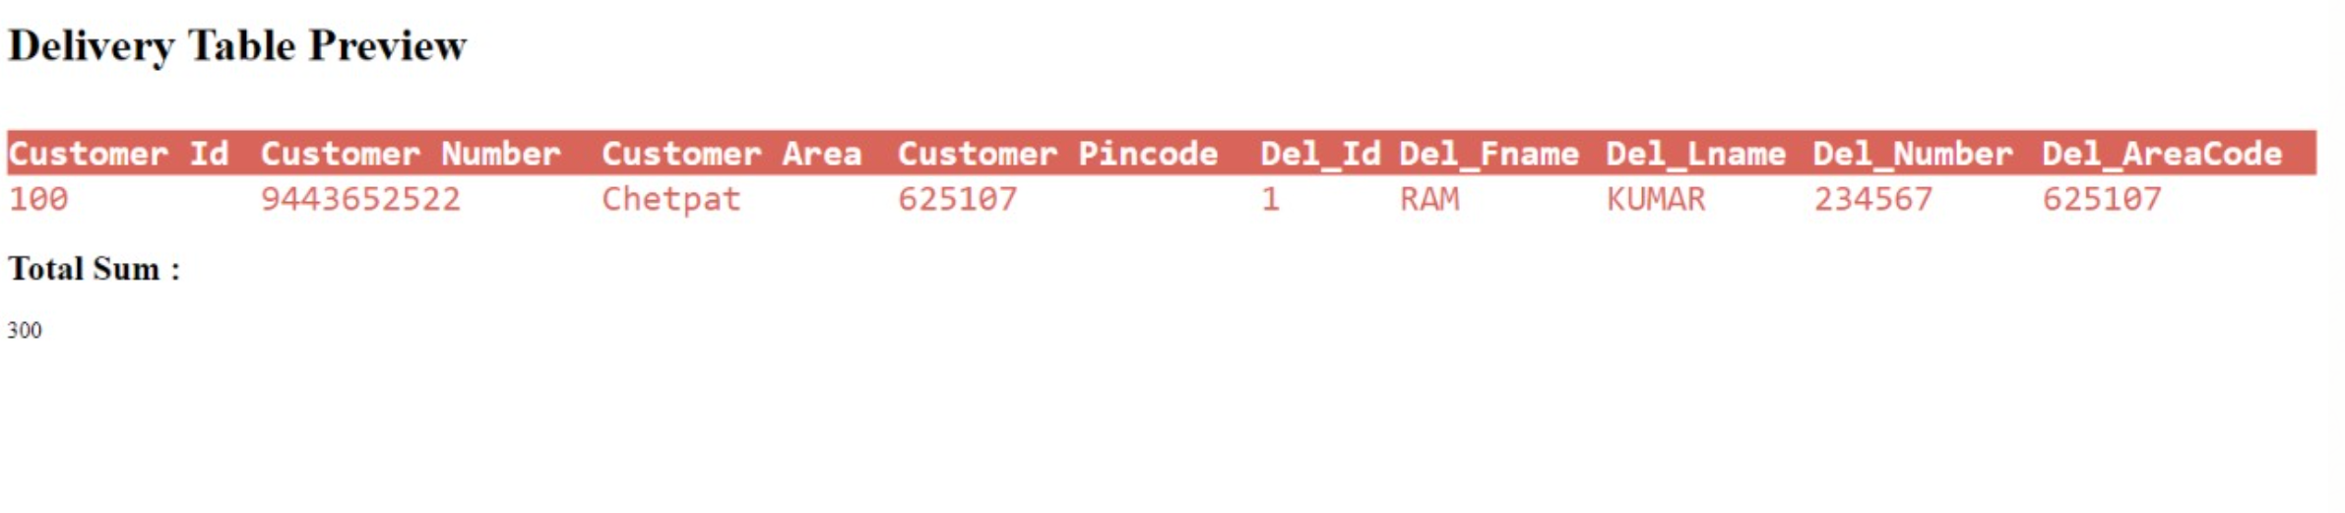

Slide 19
THANK YOU

